Slide 1
2016 Nonroad Collaborative Work Group
27 September 2018
Local Conference Lines:
EPA Region 1 (Boston): 857-702-8290 EPA Region 2 (NYC): 347-384-7287
EPA Region 3 (Philadelphia): 484-352-3221 EPA Region 4 (Atlanta): 470-705-2279
EPA Region 5 (Chicago): 312-667-7115 EPA Region 6 (Dallas): 469-250-2701
EPA Region 7 (Kansas City): 913-608-8349 EPA Region 8 (Denver): 720-642-6536
EPA Region 9 (San Francisco): 628-246-1294 EPA Region 10 (Seattle): 206-800-4483
EPA RTP (Raleigh): 984-444-7480 Main line: 202-991-0477
Conference ID: 6926578

Slide 2
Meeting Agenda
EPA Update
Nonroad 2016 beta inventory
Progress in Updating Geographic Allocation of Construction, Agriculture, Lawn & Garden, and Recreational Equipment for v1
Other business
Next meeting: October 25th @ 3:30pm EDT

Slide 3
Nonroad Work Group Members
Co-chairs: Sarah Roberts (EPA OTAQ) and Rebecca Simpson (Colorado)
Members:
Alexandra Catena – DC | Collin Smythe – VT | Mike Maleski – OH
Alison Eyth – EPA OAQPS | Dale Wells – CO | Peter Verschoor – UT
Andy Bollman – NC | Gil Grodzinsky – GA | Sonya Lewis-Cheatham – VA
Brian Sullins – AL | James Smith – TN | Susanne Cotty – Pima Co. (AZ)
Brian Timin – EPA OAQPS | Jim Koroniades – NJ | Sylvia Vanderspek – CA
Brian Trowbridge – PA | Kenneth Santlal – MA | Tim Wallace – MD
Chris Bovee – WI | Marc Bennett – MA | Tom Moore – WESTAR
Chris Kite – TX | Mark Janssen – LADCO | Vanessa Crandell-Beck – AK
Chris Rochester – NY

Slide 4
EPA Update
Nonroad 2016 beta inventory
EPA has initiated 2016, 2023, and 2028 runs for beta inventory; each year takes a little over a day to run on the cloud (Linux platform).
Will notify Work Group when nonroad beta inventories are posted on EPA’s ftp in coming weeks.
MOVES2014b Linux platform was tested by running four counties and comparing results with MOVES2014b runs done on Windows → results matched
Fulton, GA
Cook, IL
Lancaster, PA
Salt Lake, UT
Also compared results of the MOVES2014b Windows runs with existing inventories based on MOVES2014a
Equipment categories: Construction, Agricultural, Lawn & Garden, Recreational
Calendar years: 2016, 2023, 2028
Pollutants: NOx, PM2.5, VOC

Slide 5
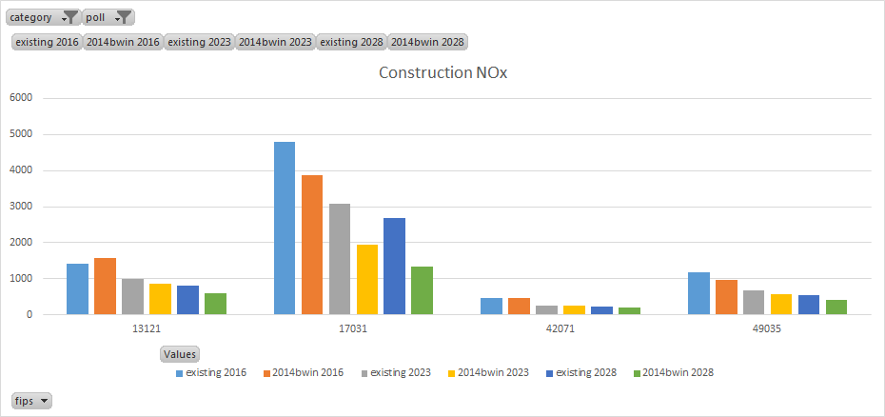
MOVES2014b County-Level Results: NOx
Fulton
Cook
Lancaster
Salt Lake

Slide 6
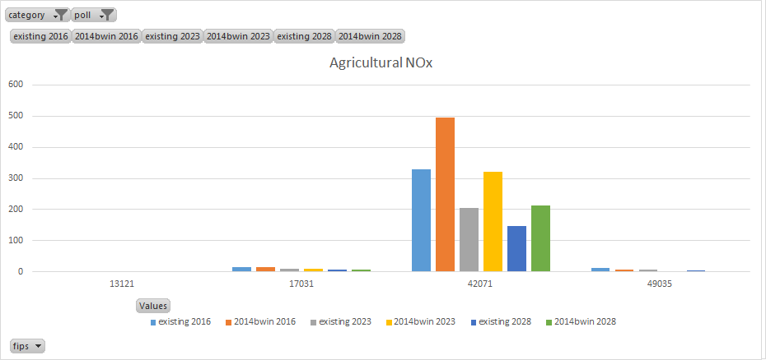
MOVES2014b County-Level Results: NOx
Fulton
Cook
Lancaster
Salt Lake

Slide 7
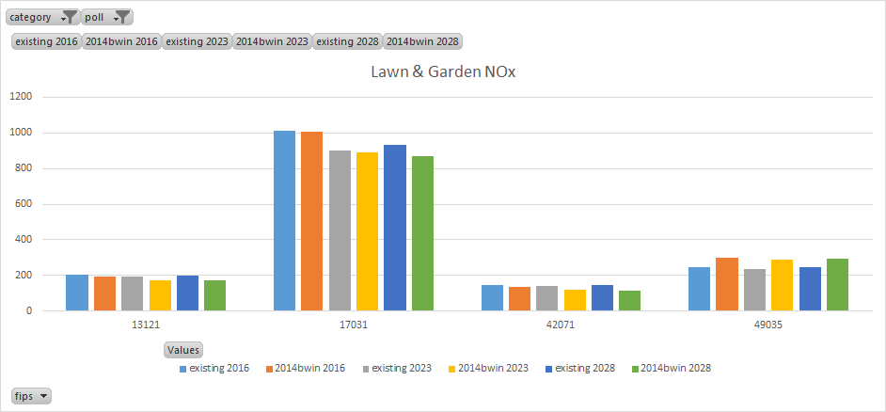
MOVES2014b County-Level Results: NOx
Fulton
Cook
Lancaster
Salt Lake

Slide 8
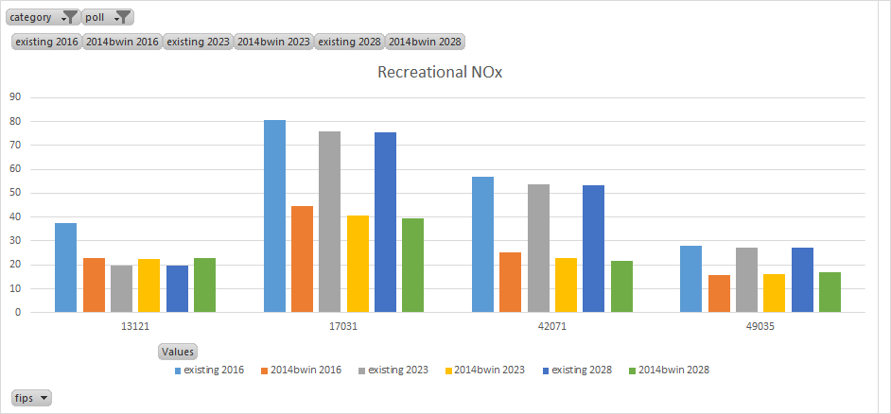
MOVES2014b County-Level Results: NOx
Fulton
Cook
Lancaster
Salt Lake

Slide 9
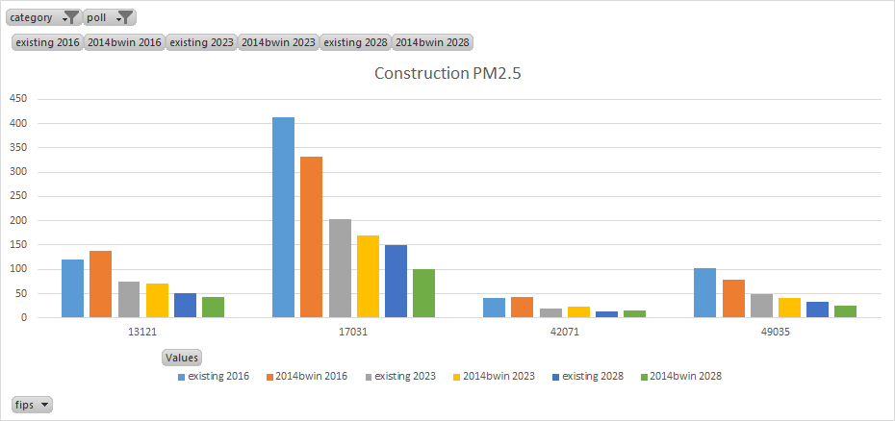
MOVES2014b County-Level Results: PM2.5
Fulton
Cook
Lancaster
Salt Lake

Slide 10
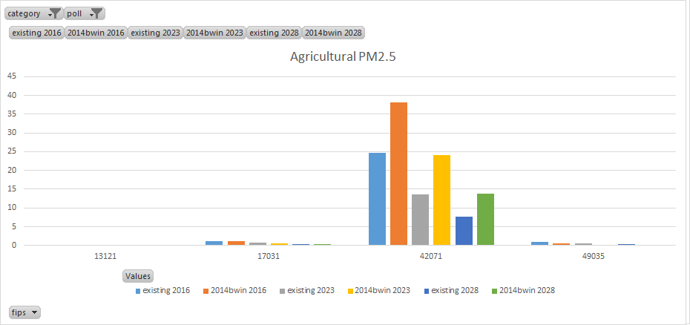
MOVES2014b County-Level Results: PM2.5
Fulton
Cook
Lancaster
Salt Lake

Slide 11
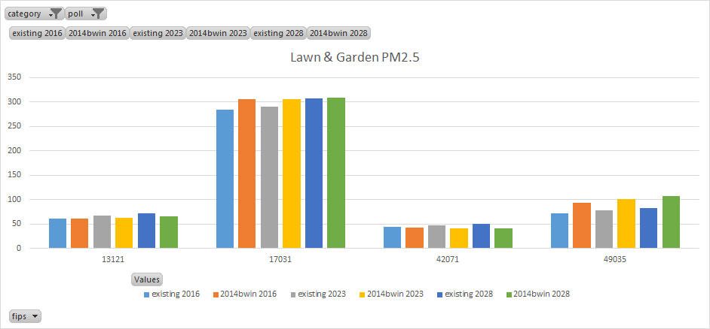
MOVES2014b County-Level Results: PM2.5
Fulton
Cook
Lancaster
Salt Lake

Slide 12
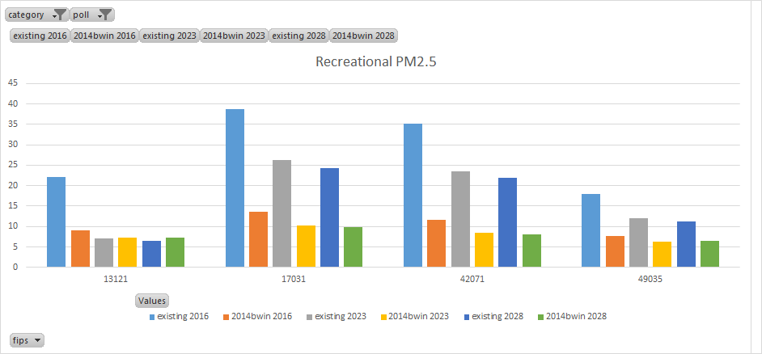
MOVES2014b County-Level Results: PM2.5
Fulton
Cook
Lancaster
Salt Lake

Slide 13
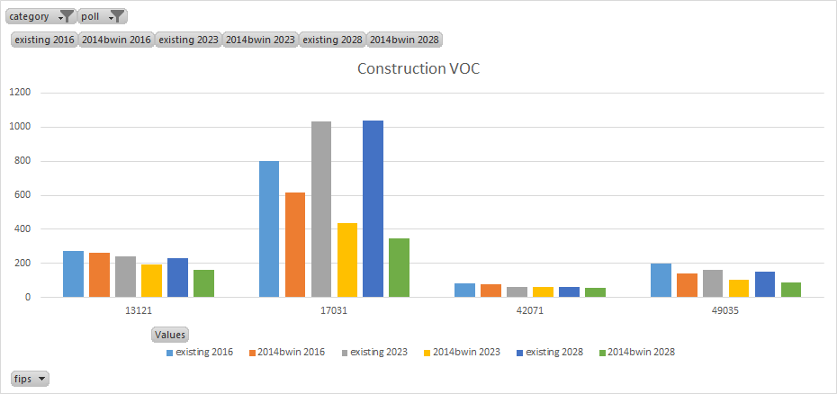
MOVES2014b County-Level Results: VOC
Fulton
Cook
Lancaster
Salt Lake

Slide 14
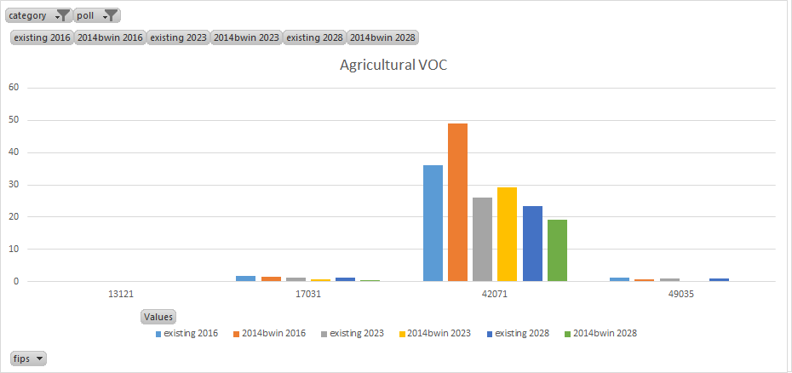
MOVES2014b County-Level Results: VOC
Fulton
Cook
Lancaster
Salt Lake

Slide 15
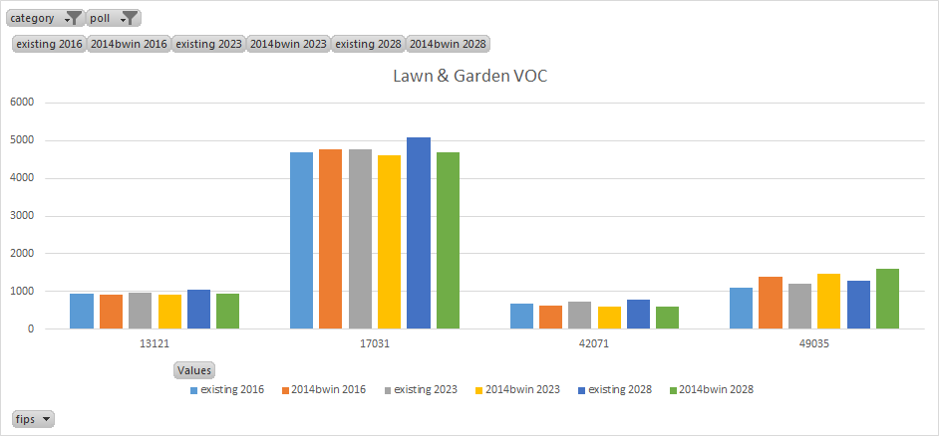
MOVES2014b County-Level Results: VOC
Fulton
Cook
Lancaster
Salt Lake

Slide 16
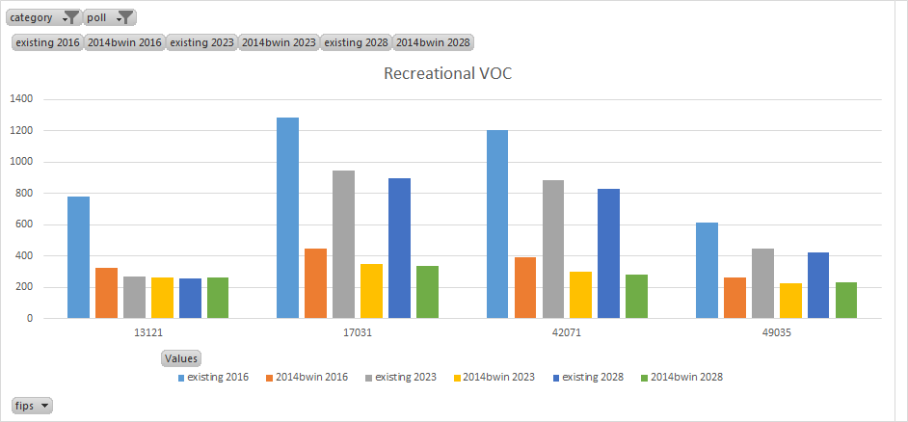
MOVES2014b County-Level Results: VOC
Fulton
Cook
Lancaster
Salt Lake

Slide 17
Other Business / Reminders
Questions and Discussion
Work Group meeting minutes and related files and links available on Work Group wiki
http://views.cira.colostate.edu/wiki/wiki/9179
Next meeting: October 25th @ 3:30pm EDT

